Slide 1


0
10
9
8
7
6
5
4
3
2
1

Slide 2

Robotics Corner

Slide 3
URDF

Slide 4
01
What is URDF
02
URDF components
AGENDA
03
Writing a simple URDF file
04
Building your robot urdf
05
Simulation

Slide 5


URDF in ROS
Make a model of your robot
01285960031
01285960031
www.roboticscorner.tech

Slide 6
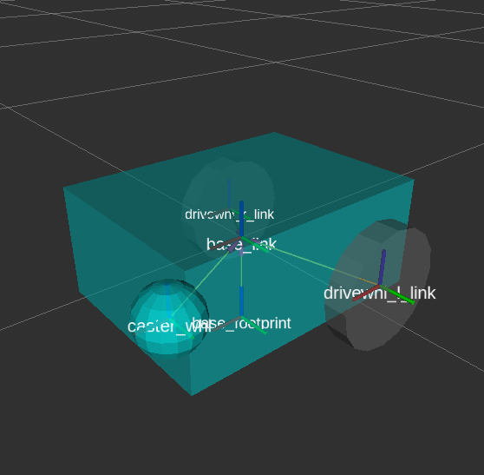
01
What is URDF
Definition
URDF, Unified Robot Description Format is an XML format for representing a robot model. URDF is commonly used in Robot Operating System tools such as rviz and Gazebo simulator. The model consists of links and joints motion.
01285960031
01285960031
www.roboticscorner.tech

Slide 7
01
What is URDF
URDF is XML, which is a text format. So you can create the files in any text editor. An IDE with good XML support is recommended.
If there already exists a CAD model of the robot, there are some tools that can be used to convert the CAD model to URDF. Here is a non-exhaustive list:
PTC Creo to URDF (iCub)
SolidWorks URDF exporter
fusion2urdf
OnShape to Robot
Phobos Blender plugin
01285960031
01285960031
www.roboticscorner.tech

Slide 8
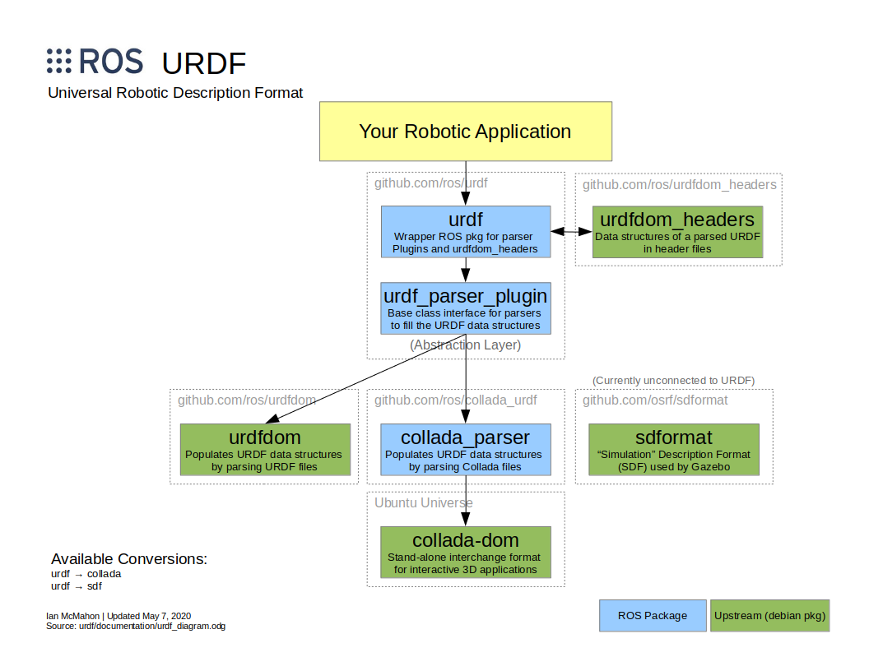
01
What is URDF
01285960031
01285960031
www.roboticscorner.tech

Slide 9
What is Gazebo
01
What is URDF
Gazeboisanopen-source3Droboticssimulator.Physicsengine
3Drendering
Sensorsimulation
IntegrationwithROS
01285960031
01285960031
www.roboticscorner.tech

Slide 10
Let’slaunchsomesimulation(video)
01
What is URDF
$sudoapt-getinstallros-<distro>-husky-simulator
$source/opt/ros/melodic/setup.bash
$exportHUSKY_GAZEBO_DESCRIPTION=$(rospackfindhusky_gazebo)/urdf/description.gazebo.xacro
$roslaunchhusky_gazebohusky_playpen.launchkinect_enabled:=true
In another terminal to check that the sensors work #activate ROS
$rqt_image_view
Inanotherterminaltocontrol #activateROS
rosrunteleop_twist_keyboardteleop_twist_keyboard.py
01285960031
01285960031
www.roboticscorner.tech

Slide 11
URDF components
02
URDF components
01285960031
01285960031
www.roboticscorner.tech

Slide 12
02
URDF components
To define a robot we have to describe all the parts(aka links) and connections between them (aka joints).
Ros and Gazebo take care of geometrical transformations (tf module), Physics simulation and rendering.
01285960031
01285960031
www.roboticscorner.tech

Slide 13
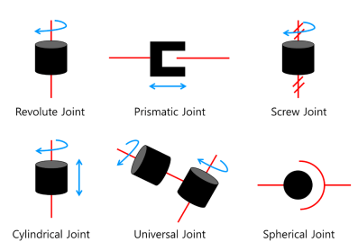

Common joint types in urdf
02
URDF components
Fixed: rigid connection
Revolute: 1D rotation
Continuous: unlimited revolutions.
Prismatic: 1D translation
Planar: 2D translation
Floating: unlimited 6D
Note: we mostly use the first 4 types
Fixed joint
Continuous joint
01285960031
01285960031
www.roboticscorner.tech

Slide 14
URDF file components
02
URDF components
Link element
Visual
Collision
Inertial
Joint element
01285960031
01285960031
www.roboticscorner.tech

Slide 15
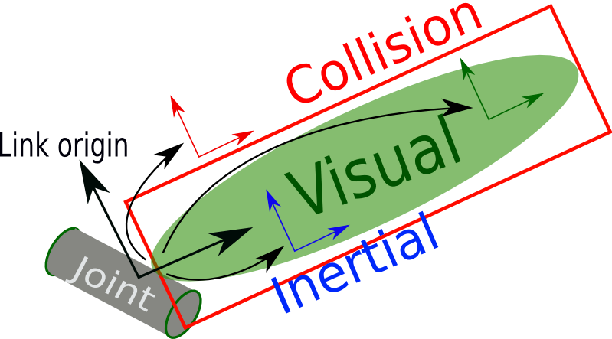

Link element
02
URDF components
<link>
<visual>
<geometry>
<cylinder/>
</geometry>
<origin/>
</visual>
<collision>
<geometry>
<cylinder/>
</geometry>
<origin/>
</collision>
<inertial>
<mass>
<origin>
<inertia/>
</inertial>
</link>
01285960031
01285960031
www.roboticscorner.tech

Slide 16
Visual
02
URDF components
<visual>
<geometry>
<cylinder/>
</geometry>
<origin/>
</visual>
Visual
Joint
01285960031
01285960031
www.roboticscorner.tech

Slide 17
Collision
02
URDF components
<collision>
<geometry>
<cylinder/>
</geometry>
<origin/>
</collision>
Visual
Joint
01285960031
01285960031
www.roboticscorner.tech

Slide 18
Inertial
02
URDF components
<inertial>
<mass>
<origin>
<inertia/>
</inertial>
Visual
Joint
01285960031
01285960031
www.roboticscorner.tech

Slide 19
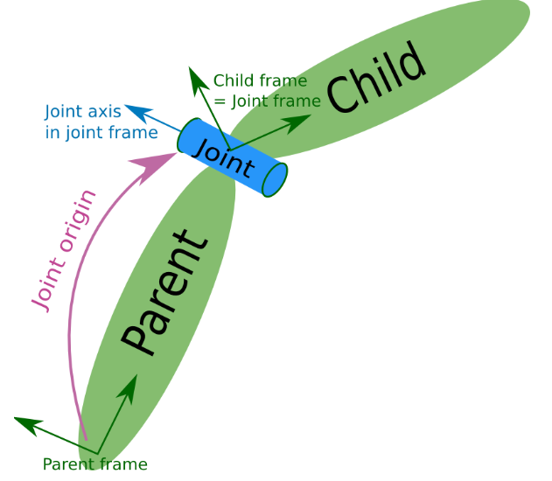
Joint element
02
URDF components
<joint name="my_joint" type="">
<origin/>
<parent link="link1"/>
<child link="link2"/>
</joint>
01285960031
01285960031
www.roboticscorner.tech

Slide 20
Make a URDF
03
Make a URDF
01285960031
01285960031
www.roboticscorner.tech

Slide 21
We can make a simple shape first
03
Make a URDF
First make a urdf folder in the package
Mkdir urdf
Then make the file:
Touch oneshape.urdf
Follow the code in this link:
http://wiki.ros.org/urdf/Tutorials/Building%20a%20Visual%20Robot%20Model%20with%20URDF%20from%20Scratch
01285960031
01285960031
www.roboticscorner.tech

Slide 22
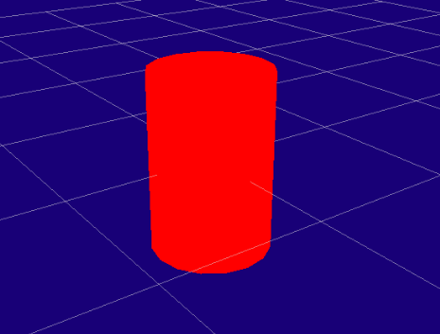
Simple shape urdf:
03
Make a URDF
<?xml version="1.0"?>
<robot name="myfirst">
<link name="base_link">
<visual>
<geometry>
<cylinder length="0.6" radius="0.2"/>
</geometry>
</visual>
</link>
</robot>
01285960031
01285960031
www.roboticscorner.tech

Slide 23
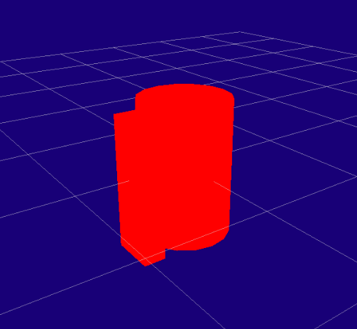
Add more shapes and joint:
03
Make a URDF
<robot name="origins">
<link name="base_link">
<visual>
<geometry>
<cylinder length="0.6" radius="0.2"/>
</geometry>
</visual>
</link>
<link name="right_leg">
<visual>
<geometry>
<box size="0.6 0.1 0.2"/>
</geometry>
<origin rpy="0 1.57075 0" xyz="0 0 -0.3"/>
</visual>
</link>
<joint name="base_to_right_leg" type="fixed">
<parent link="base_link"/>
<child link="right_leg"/>
<origin xyz="0 -0.22 0.25"/>
</joint> </robot>
01285960031
01285960031
www.roboticscorner.tech

Slide 24
Building your robot URDF
04
Building your robot urdf
01285960031
01285960031
www.roboticscorner.tech

Slide 25
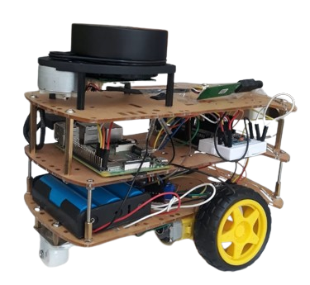
This is our robot
04
Building your robot urdf
It consists of:
2 wheels in the back
1 front wheel
Lidar
Body
Electrical components
01285960031
01285960031
www.roboticscorner.tech

Slide 26
Make an environment in gazebo
05
Simulation
01285960031
01285960031
www.roboticscorner.tech

Slide 27
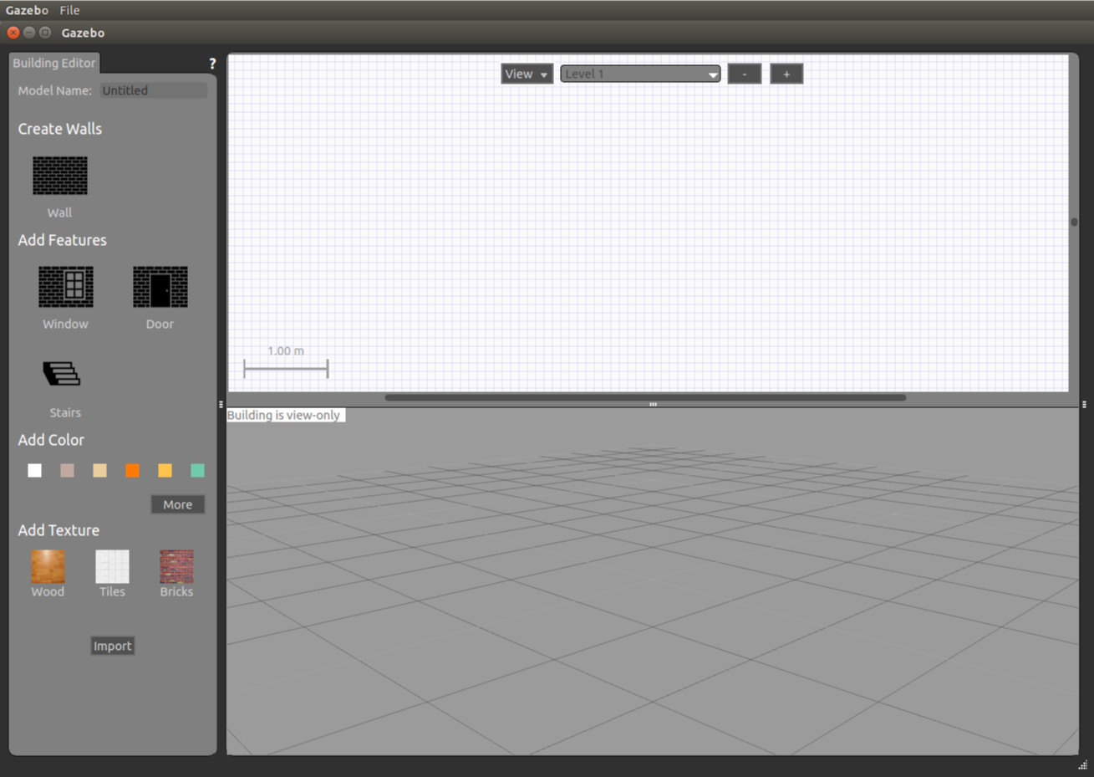
05
Simulation
01285960031
01285960031
www.roboticscorner.tech

Slide 28
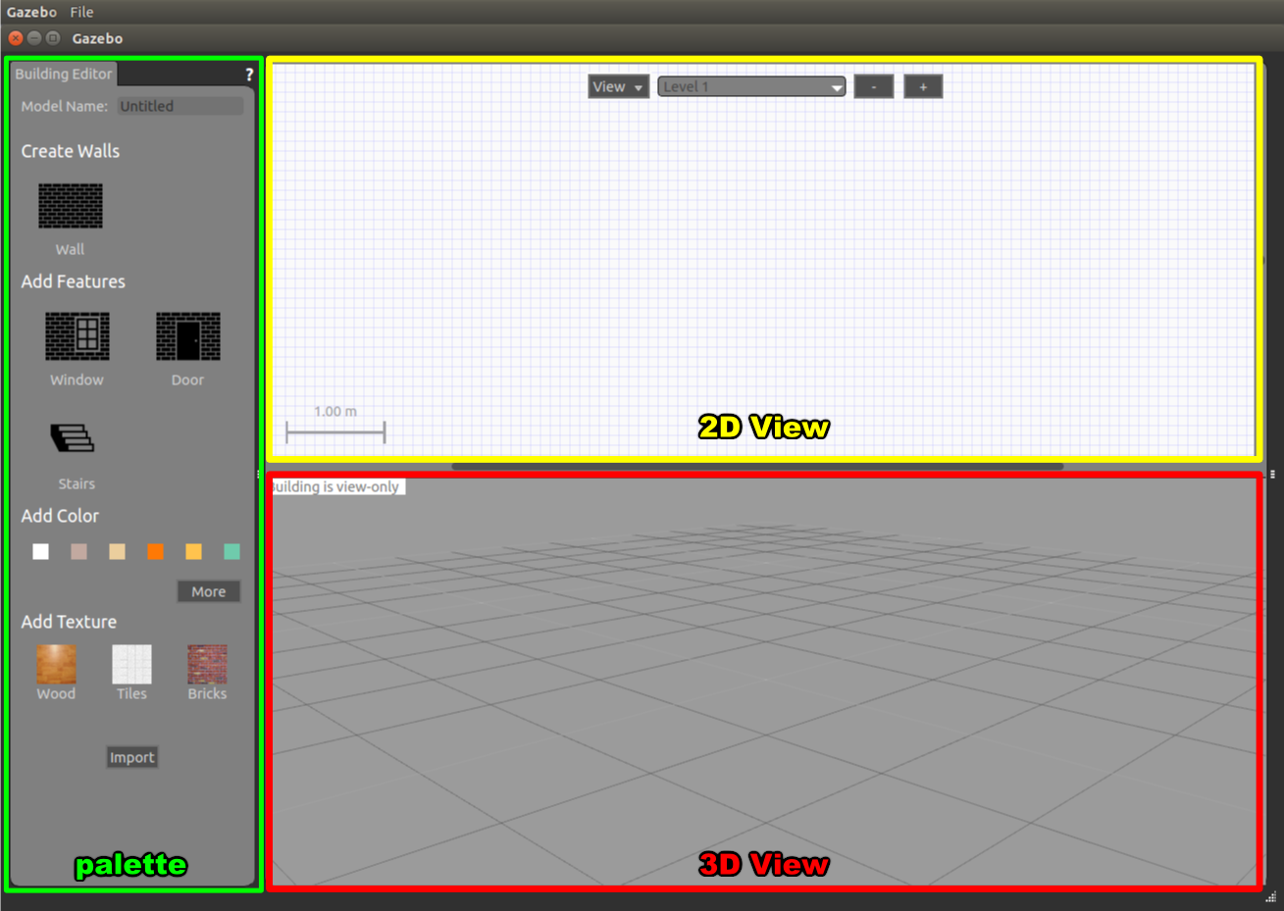
05
Simulation
01285960031
01285960031
www.roboticscorner.tech

Slide 29
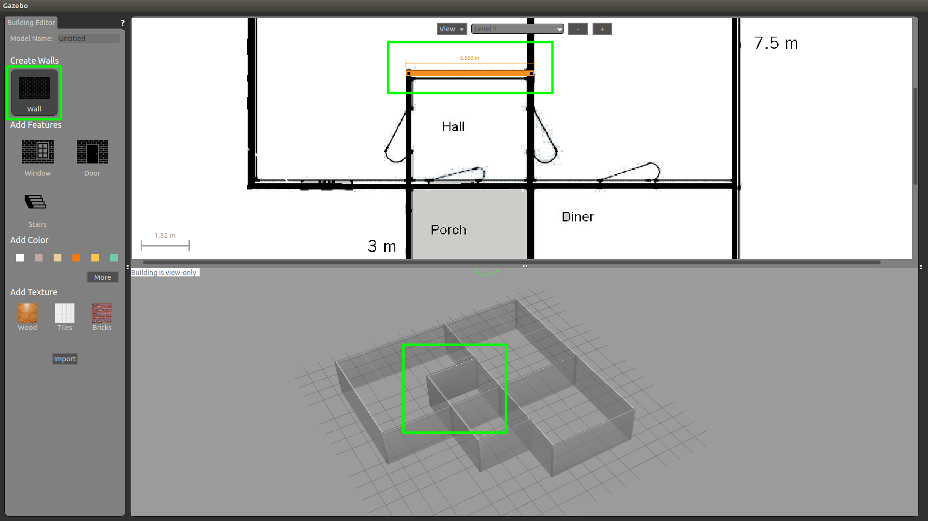
Adding walls
05
Simulation
01285960031
01285960031
www.roboticscorner.tech

Slide 30
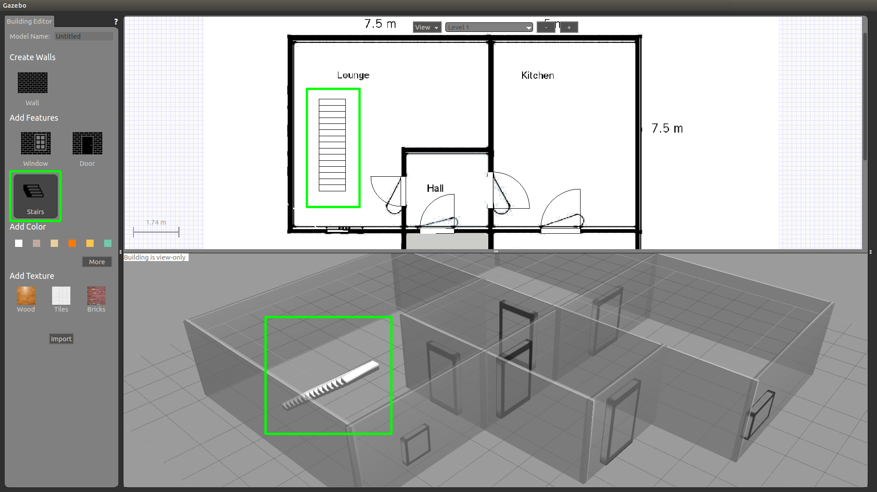
Add stairs
05
Simulation
01285960031
01285960031
www.roboticscorner.tech

Slide 31
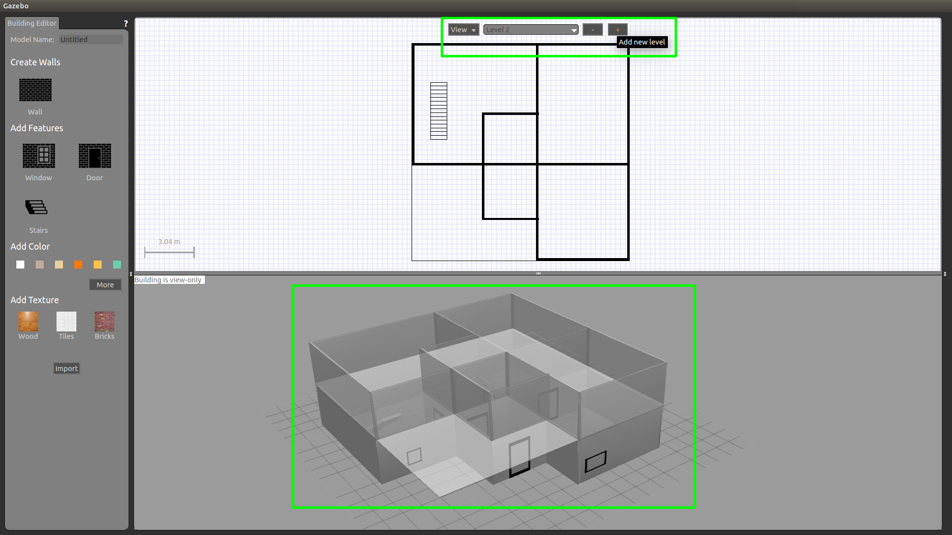
Add levels
05
Simulation
01285960031
01285960031
www.roboticscorner.tech

Slide 32
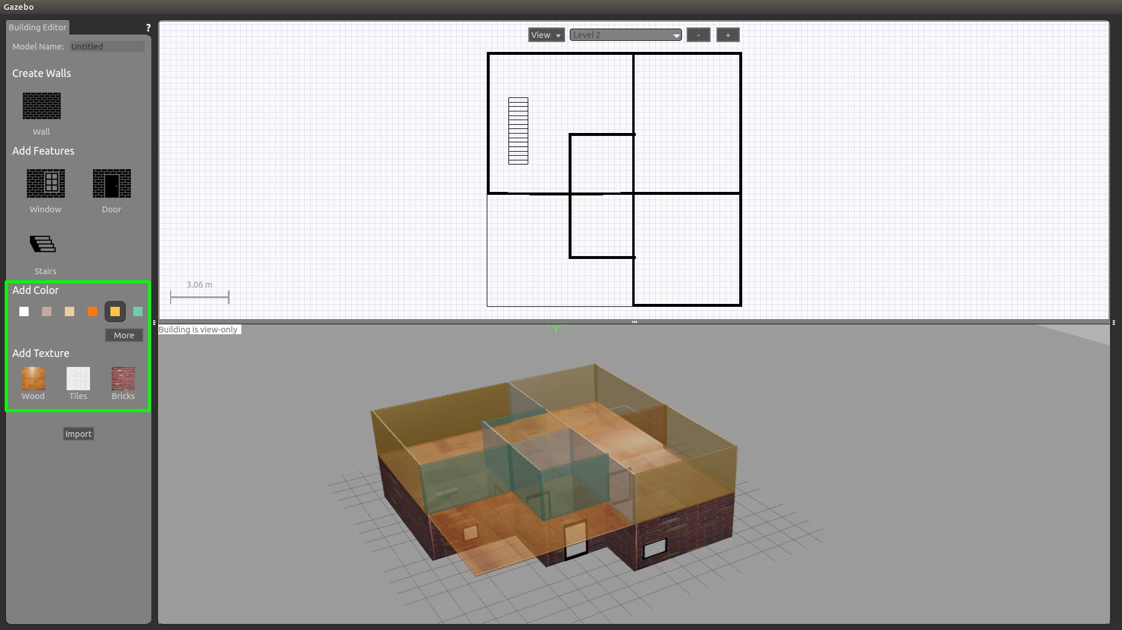
Change colors
05
Simulation
01285960031
01285960031
www.roboticscorner.tech

Slide 33
Resources for learning
00
Resources
Tutorialshttp://wiki.ros.org/urdf_tutorial
http://gazebosim.org/tutorials
Learningbycopyingturtlebot3https://emanual.robotis.com/docs/en/platform/turtlebot3/simulation/
huskyhttp://wiki.ros.org/husky_gazebo/Tutorials/Simulating%20Husky
husky+slamhttps://github.com/incebellipipo/carto_demo
Moreadvancedexampleshttps://github.com/AutoRally/autorally
https://mushr.io/tutorials/intro-to-ros/
01285960031
01285960031
www.roboticscorner.tech

Slide 34



Slide 35

01211626904
www.roboticscorner.tech
Robotics Corner
Robotics Corner
Robotics Corner
Robotics Corner

